Slide 1
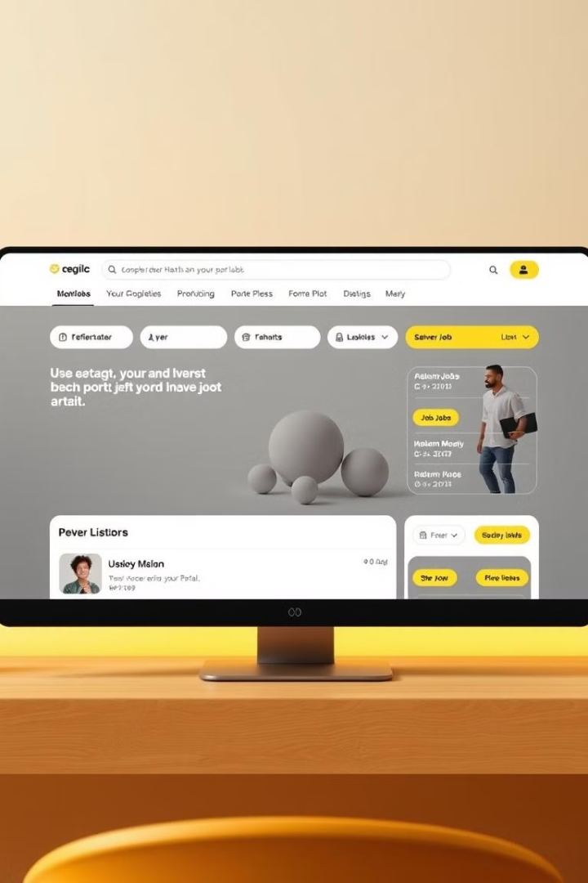
JobLink Portal Presentation
This presentation outlines the development plan for a comprehensive job portal, designed to connect job seekers and employers efficiently.

Slide 2
Course Name : Software Engineering and System Analysis Lab
Course Code : CSE-356
Project Name : JobLink Portal
Presented by :
Submitted To :
Md Fahim Chowdhury (2215151127)
Engineer Md. Safaet Hossain
Md. Rayhan Ahmed Shis (2125051067)
Associate Professor and Director, IQAC DEPT. of CSE ,UITS
Sadia Ahmed mou (2215151145)
Jarin Jubuyer jui (2215151141)
Propa Punam
Lecturer
DEPT. of CSE ,UITS

Slide 3

Objectives
1
Streamline Recruitment
2
Expand Job Seeker Network
Simplify the job application process for both candidates and employers, saving time and resources.
Increase the pool of qualified candidates by providing access to a diverse range of job opportunities.
3
Enhance Employer Branding
4
Promote Career Development
Offer employers tools to showcase their company culture and attract top talent.
Empower job seekers with resources and tools to advance their careers.

Slide 4

Introduction
1
Problem
Traditional job search methods are often inefficient, time-consuming, and lacking in transparency.
2
Solution
A user-friendly job portal platform that connects employers and job seekers seamlessly.
3
Benefits
Provides a centralized platform for job postings, applications, and communication, fostering a more efficient and effective recruitment process.

Slide 5
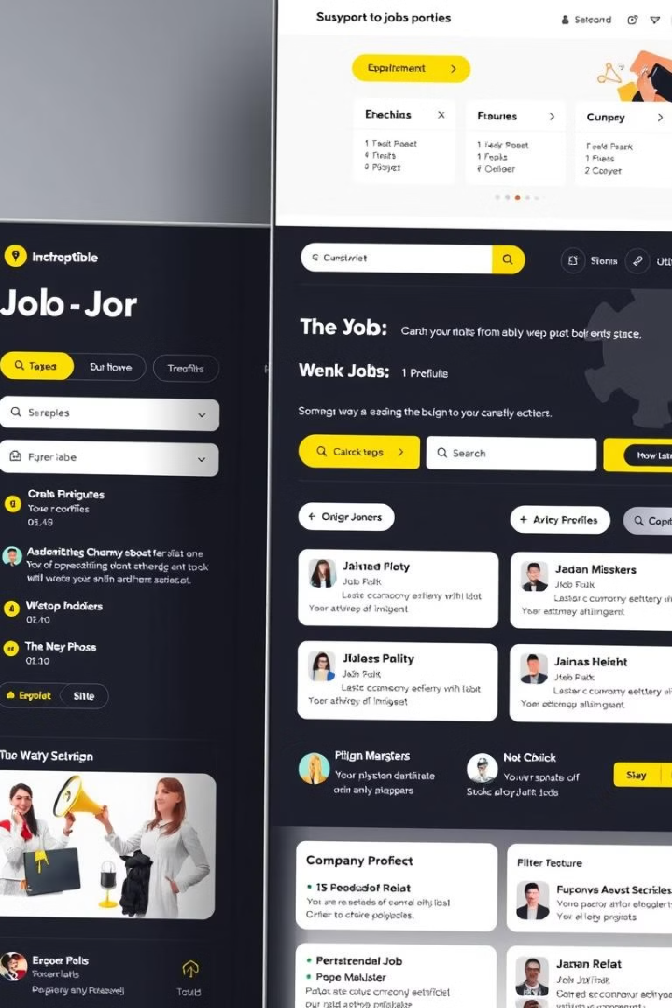
Software Features Description
Job Posting
Candidate Search
Employers can create detailed job postings, including job descriptions, qualifications, and application instructions.
Job seekers can search for relevant job openings using keyword searches, filters, and advanced search options.
Application Management
Communication Tools
Candidates can apply for jobs directly through the platform, and employers can track applications and manage the hiring process.
The platform facilitates communication between employers and candidates, including messaging, email, and video conferencing features.

Slide 6
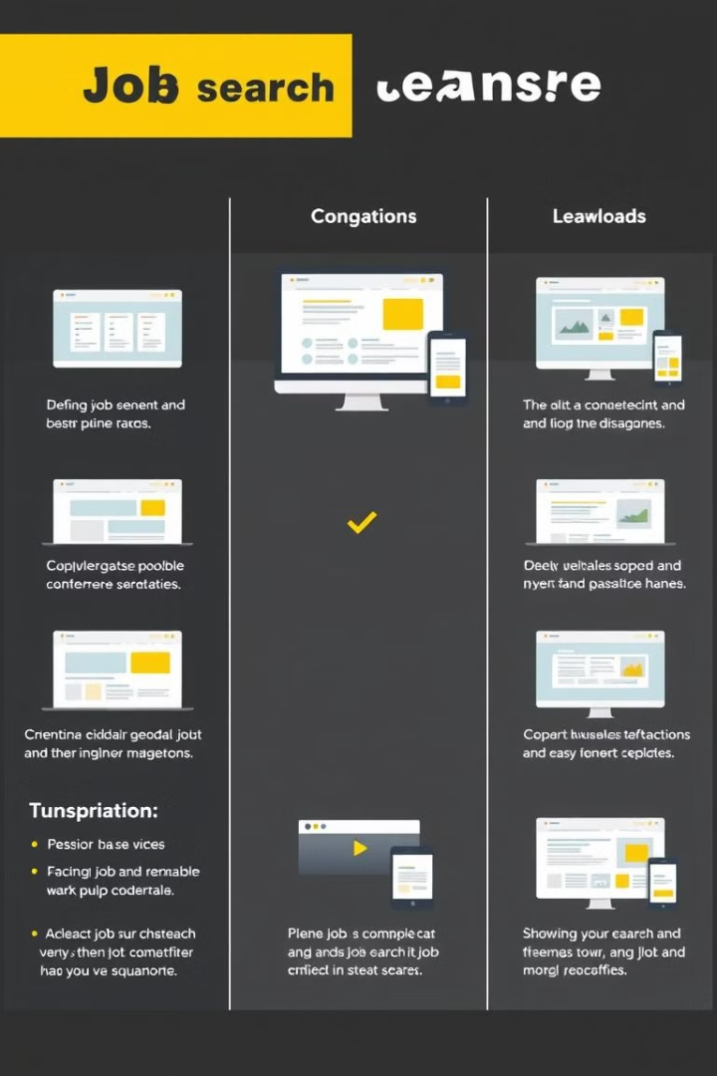
Comparison with Existing Softwares
Feature
Our Portal
BDJobs
CareerJet
User Interface
Modern and intuitive
Outdated design
Cluttered layout
Job Search Functionality
Advanced filters and search options
Limited search capabilities
Lack of customization options
Communication Features
Integrated messaging and video conferencing
Limited communication options
External communication required
Mobile Responsiveness
Fully optimized for mobile devices
Limited mobile functionality
Desktop-only platform

Slide 7
Front-end Requirements
HTML
CSS
JavaScript
Structure and layout of the website, ensuring a user-friendly and visually appealing experience.
Styling and design elements, creating a cohesive visual identity and enhancing user experience.
Dynamic functionality, enabling interactive elements, data validation, and improved user interaction.

Slide 8





Back-end Requirements
Database Management
Securely store and manage user data, job listings, and other relevant information.
User Authentication
Implement robust authentication mechanisms to protect user accounts and ensure data security.
API Integration
Connect with third-party services such as payment gateways, social media platforms, and analytics tools.
Security Measures
Implement security protocols to protect against cyber threats, data breaches, and unauthorized access.

Slide 9
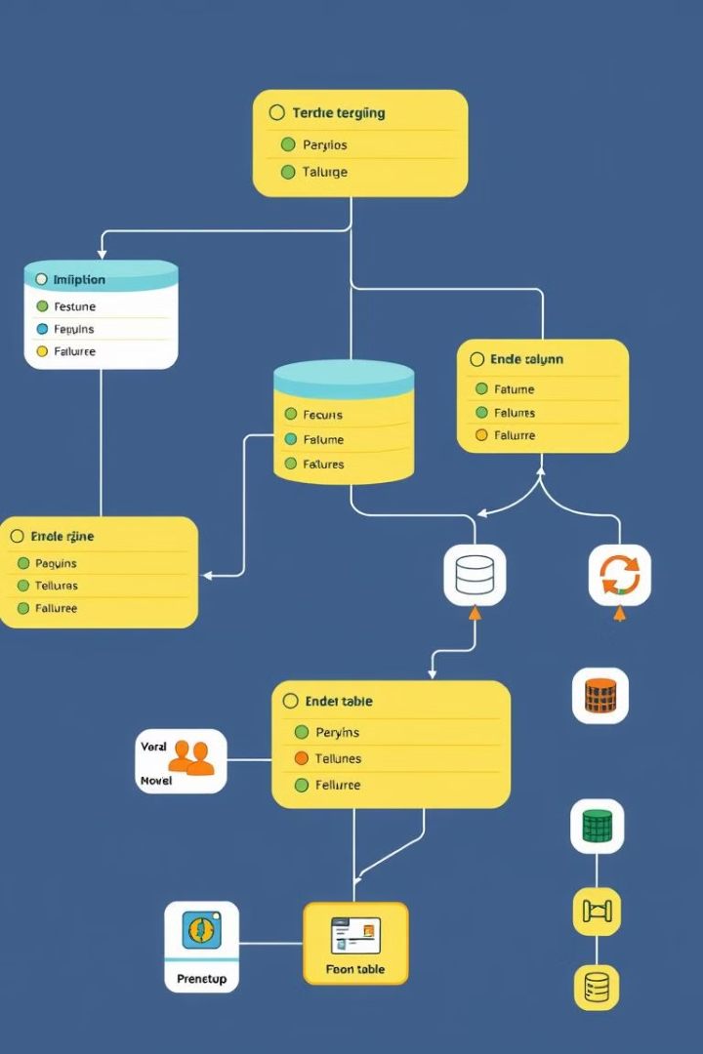




Database Requirements
Relational Database Management System (RDBMS)
User Tables
To store information about registered users, including their contact details, login credentials, and job preferences.
To store and manage structured data such as user profiles, job listings, and application details.
Job Listing Tables
Application Tables
To store details about each job posting, including the job title, description, location, and company information.
To track applications submitted by candidates, including their resume, cover letter, and application status.

Slide 10
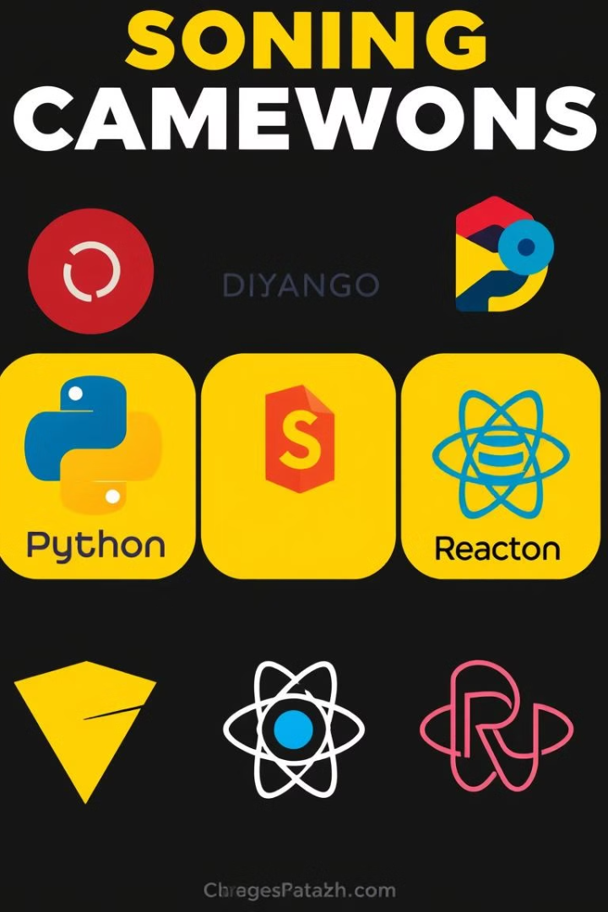
Programming Language and Framework
1
Python
2
Django
A versatile and popular language, well-suited for web development and data processing tasks.
A powerful Python framework that provides a robust structure for building complex web applications.
3
JavaScript
4
React
Essential for interactive front-end development, ensuring a dynamic and engaging user experience.
A popular JavaScript library for building user interfaces, offering flexibility and efficiency in front-end development.

Slide 11

References
List of relevant resources and articles related to job portals, software development, and recruitment best practices.
BDJobs (Largest Job Site in Bangladesh, Search Jobs | Bdjobs.com)
CareerJet [Careerjet.com.bd - Jobs & Careers in Bangladesh]
Ejobs [eJobs - Largest Jobs Portal in Bangladesh]

Slide 12

Conclusion and Key Takeaways
Job portals have revolutionized the hiring process, providing a convenient and efficient platform for job seekers and employers. By embracing technology and focusing on user experience, job portals continue to play a vital role in connecting talent with opportunities.

